Slide 1
Analysis of Longitudinal Data
Continuous Response: Part 1
Usha Sambamoorthi^{1,2,3}
¹ HSR& D Center, East Orange VA
²School of Public Health, UMDNJ
³IHHCPAR, Rutgers University
08 April 2005

Slide 2
Objectives
Mention various methods of analyzing longitudinal data
Non-statistical view point
Build and develop mixed effects models using PROC MIXED procedure in SAS
interpret findings

Slide 3
At the end of this session you will learn
Know about fixed effects, random effects
graphical data analysis using SAS Proc GPLOT
To build models using SAS Proc mixed
To read SAS Proc mixed output
how to interpret findings
to summarize results for publications

Slide 4
Types of Longitudinal Data
Repeated Cross-sections
Different samples are taken at each measurement time, to measure trends not individuals experiences
Examples
National Health Interview survey (NHIS)
Behavioral Risk Factor Surveillance Study (BRFSS)

Slide 5
Types of Longitudinal Data
Time Series
Collection of data X_{t} (t = 1, 2, …, T) with the interval between X_{t} and X_{t+1} being fixed and constant. In time-series studies, a single population is assessed with reference to its change over the time
Here we measure trend, seasonality
EXAMPLES
  Daily, weekly, or monthly performance of a stock
  Daily pollution levels in a city
  Annual measurements of sun spots

Slide 6
Types of Longitudinal Data
Panel or Multi-level Data
Same individual/subject/unit is observed over two or more time points. Typically large number of observations repeated over a few time points
i = 1,2,3…. N
t = 1,2,3… T
Examples
Medical Expenditure Panel Survey – Households followed over a period of 2 years – 5 rounds
Medicare Current Beneficiary Survey – Individuals followed for a maximum of 4 years

Slide 7
Types of Longitudinal Data
Clustered or Hierarchical Data
The observations have a multi-level structure (Same patients (i) from facilities (k) followed over time (t))
k = 1,2,3…. K
i = 1,2,3…. N
t = 1,2,3… T
Example
Minimum Data Set (MDS) – Quarterly and Annual clinical information on nursing home residents

Slide 8
Types of Responses in Longitudinal Data
  Continuous – Cost of health care
  Discrete – Use or non-use of mental health services
  count – number of outpatient visits
  survival – time from diagnosis to death

Slide 9
Challenges in Analyzing Longitudinal Data
Account for dependency of observations
Both dependent and independent variables change over time –time varying covariates
Invariable presence of missing data
  Analysis on completers
  Last observation carried forward (LOCF)

Slide 10
Designs of Longitudinal Data
Equally spaced or balanced panel data
  When each subject is scheduled to be measured at the same set of times (say, t₁, t₂, …, t_{n}), then resulting data is referred as equally-spaced or balanced data
Unequally spaced or unbalanced data
  When subjects are each observed at different sets of times
  there are missing data

Slide 11
Traditional models (OLS) can not be applied to Longitudinal data
OLS Model Assumes residuals are independently distributed (ie no correlation); E ( εi, εj) = 0
Consequences when this assumption is violated
  OLS co-efficient estimates are not biased
  OLS estimates do not have the minimum variance; inefficient estimates (Standard errors may be large)
  biased tests of hypothesis leading to incorrect conclusions
In longitudinal data repeat observations within a subject are usually correlated over time
Variances within subjects can vary over time

Slide 12
Traditional models (OLS) can not be applied to Longitudinal data
assumes homoskedasticity; E ( ε_{i}² ) = σ²
Consequences when this assumption is violated
  OLS co-efficient estimates are not biased
  OLS estimates do not have the minimum variance; inefficient estimates (Standard errors may be large)
  biased tests of hypothesis leading to incorrect conclusions
In longitudinal data variances within subjects can vary over times

Slide 13
Effect of violating OLS assumptions on standard error estimates of independent variables
If there is positive correlation of observations within a subject
Time-independent explanatory variables: gender, race/ethnicity
  Standard error estimates will be underestimated
  Leads to incorrect tests of significance
Time-varying covariates: blood pressure values, severity of illness, drug use
  Standard error estimates will be overestimated
  Leads to incorrect tests of significance

Slide 14
Requirements for
Longitudinal Models
capture trend over time while taking account of the correlation that exists between successive measurements
describe the variation in the baseline measurement and in the rate of change over time
Explain the variations in baseline measurement and trends by relevant covariates

Slide 15
Analysis Considerations for
Longitudinal Data
Balanced or equally spaced vs unbalanced data
Type of dependent variable – Continuous, non-normal (counts), ordinal (poor to excellent health), nominal (binary)
# of subjects – more advanced models are based on large sample theory – N < 30 ???
# and type of covariates
Selecting possible covariance structure
# of observations per subject
  If only 2, compute change scores, use simple methods

Slide 16
Minimum time periods
1) A minimum of 4 time points is recommended; With < 4 time points, it is not possible to identify enough parameters in the growth model to make the model flexible
2) 4 time points give more power
3) with 3 time points restrictions need to be placed on the growth models

Slide 17
Models for longitudinal data
Derived variable approach – summary score, change score ..
ANOVA for repeated measures (assumes compound symmetry – constant variance and covariance over time)
  Allows for different intercepts – but no time trend (subjects can deviate only in baseline measures but consistent thereafter)
MANOVA for repeated measures ( does not permit missing data, or different measurement periods for subjects)
Mixed Effects Models
  – Applicable to all types of outcomes (normal, non-normal,categorical)
  – Robust to missing data (irregularly spaced observations)
  – Can handle both time-variant and time-invariant covariables

Slide 18
Models for longitudinal data
Covariance Pattern Models
  – Does not distinguish “within” and “between” subject variation
Generalized Estimating Equation (GEE) Models
  – missing data are only ignorable if the missing data are explained by covariates in the model

Slide 19
Covariance Patterns – Compound symmetry/Exchangeable
Exchangeable
Time 1
Time 2
Time 3
Time 4
Time 1
1
p
p
p
Time 2
1
p
p
Time 3
1
p
Time 4
1

Slide 20
Covariance Patterns – Autoregressive (first order)
Autoregressive (first order) - with this structure, the correlations decrease over time. Correlations one measurement apart are assumed to be p, correlations two measurements apart are assumed to be p²,etc. In general, measurements t are assumed to be p^{t}
Autoregressive
Time 1
Time 2
Time 3
Time 4
Time 1
1
p
p²
P³
Time 2
1
p
p²
Time 3
1
p
Time 4
1

Slide 21
Covariance Patterns – Toeplitz
Toepltiz - Generalizes the AR(1) structure by assuming that observations within a subject that are the same time-distance apart have the same correlation.
Autoregressive
Time 1
Time 2
Time 3
Time 4
Time 1
1
p¹
p²
P³
Time 2
1
p¹
p²
Time 3
1
p¹
Time 4
1

Slide 22
Covariance Patterns – Spatial
Spatial - More general Generalizes the AR(1) structure for unequally spaced data.
Unstructured
Time 1
Time 2
Time 3
Time 4
Time 1
1
P₁₋₂
P₁₋₃
P₁₋₄
Time 2
1
P₂₋₃
P₂₋₄
Time 3
1
P₃₋₄
Time 4
1

Slide 23
Covariance Patterns – Unstructured
Unstructured: Correlations for each time pairs are different. This is the structure used in multivariate ANOVA.
Unstructured
Time 1
Time 2
Time 3
Time 4
Time 1
1
p₁
p₂
p₃
Time 2
1
p₄
p₅
Time 3
1
p₆
Time 4
1

Slide 24
Selecting Covariance Patterns
Choose relevant structure
Not all structures are applicable to all data
Equal spacing:
CS,
Unstructured
AR(1)
Toeplitz
Spatial
Unequal Spacing:
CS
UN
Spatial

Slide 25
Fixed Effects – Least Square Dummy Variable Model
LSDV approach takes care of within subject correlation by using dummy variables for class effects
  To capture individual effect, individual dummies are included; If there are 100 individuals, 99 dummy variables representing 99 individuals are included; To capture time effect, time dummies are included; if there are 10 time periods, 9 time dummies are included
Cons
  Large number of observations needed, DF quickly reduced
  Time-constant covariates such as gender can not be included

Slide 26

Mixed Effects Models
Models means and variances / covariances
Has both random and fixed effects
What is a fixed effect?
Each person is unique ; has his/her own baseline and growth trajectory
In terms of covariates – they represent all the values in the population
If A,B, C are drugs, they are do not represent a random sample of drugs from a population; so the inferences are applicable for only A,B,C and not drug D

Slide 27
Random Effects
For each unit, baseline value is the result of a random deviation from some mean intercept. The intercept is drawn from some distribution for each unit, and it is independent of the error for a particular observation; we just need to estimate parameters describing the distribution from which each unit’s intercept is drawn
Facilities – could be considered as random if they are random sample from a population

Slide 28
When to use
Fixed vs Random Effects
  Depends on research question
  When to use fixed effect?
  If interested in the mean of an outcome
  contains all values
  Example: Race, Gender, Age
  When to use random effect?
  If interested in the variance of an outcome
  Sampled from a population of values
  Example: Facilities, nursing homes, time

Slide 29
Data Source
104 Respondents
Respondents are interviewed in 4 waves
Interval between interviews varied across observations
Both time varying and time-invariant characteristics

Slide 30
Study Objectives
Within person comparisons
  How does an individual’s vitality change over time?
  What is the rate of change?
Between person comparisons
  How is the change in vitality level associated with comorbid FM and age?
  Do individuals with out comorbid FM have more stable baseline and change rate than those with comorbid FM?
  How do we summarize these results for a journal article?

Slide 31
Measures: Dependent and Independent Variables
Time Invariant
Presence of Comorbid FM
  Yes
  No
Age (continuous)
  Baseline Age
  Varies from xx to xxx
Time Varying covariates
Becker Depression Inventory Score
  Range 0 to xxx
  Xx items
Time Variables
# of interviews (waves)
  1 - 4
  1 person had 3 interviews
Time
  Baseline coded as zero
  Time since baseline measured in months
Dependent Variable
SF-36 Vitality Score

Slide 32
Building models
Exploratory data analysis – Descriptive statistics, individual group profiles, plots
Begin with simple models and build towards more complex models
Decide fixed and random components
Select covariance structure
Model diagnostics

Slide 33
Organize/list data proc print data=a(obs=25); title 'Line Listing of Vitality Data' ; run;
Line Listing of Vitality Data
Obs id flup fm time age sf_vt bdi_deprn
1 10029 1 0 0.00 45.49 70 2
2 10029 2 0 9.38 45.49 55 0
3 10029 3 0 16.33 45.49 45 2
4 10029 4 0 25.90 45.49 70 0
5 10057 1 0 0.00 57.95 10 5
6 10057 2 0 9.11 57.95 5 0
7 10057 3 0 22.36 57.95 25 13
8 10057 4 0 30.13 57.95 5 13
9 10138 1 0 0.00 47.60 5 2
10 10138 2 0 6.85 47.60 15 0
11 10138 3 0 15.70 47.60 25 2
12 10138 4 0 24.26 47.60 30 1
13 10155 1 0 0.00 33.39 15 0
14 10155 2 0 5.70 33.39 0 9
15 10155 3 0 12.33 33.39 10 13
16 10155 4 0 18.98 33.39 10 0
17 10163 1 1 0.00 47.35 5 17
18 10163 2 1 11.21 47.35 0 0
19 10163 3 1 28.43 47.35 5 17
20 10163 4 1 36.79 47.35 0 14
21 10185 1 0 0.00 43.32 10 11
22 10185 2 0 8.98 43.32 25 23
23 10185 3 0 20.16 43.32 15 22
24 10185 4 0 35.93 43.32 25 0
25 10221 1 1 0.00 36.92 5 4

Slide 34
Check data proc means data=a maxdec= 2 n min max mean median std; title 'Descriptive Statistics vitality data‘ ; run;
Inference:
1 to 4 waves
51% had FM
Vitality ranged from 0 70 Maximum; large variation
time of follow up 38 months
Age range: 26 to 58 years
Descriptive Statistics vitality data
The MEANS Procedure
Variable Label N Minimum Maximum
ƒƒƒƒƒƒƒƒƒƒƒƒƒƒƒƒƒƒƒƒƒƒƒƒƒƒƒƒƒƒƒƒƒƒƒƒƒƒƒƒƒƒƒƒƒƒƒƒƒƒƒƒƒƒƒƒƒƒƒƒƒƒƒƒƒƒƒƒƒƒƒƒƒƒƒ
id Case ID 239 10029.00 10880.00
flup Followup nbr 239 1.00 4.00
fm FM 239 0.00 1.00
time 239 0.00 38.66
age age at baseline 239 26.65 57.95
sf_vt SF-Vitality 239 0.00 70.00
bdi_deprn Becker Depression inventory 239 0.00 38.00
ƒƒƒƒƒƒƒƒƒƒƒƒƒƒƒƒƒƒƒƒƒƒƒƒƒƒƒƒƒƒƒƒƒƒƒƒƒƒƒƒƒƒƒƒƒƒƒƒƒƒƒƒƒƒƒƒƒƒƒƒƒƒƒƒƒƒƒƒƒƒƒƒƒƒƒ
Variable Label Mean Median
ƒƒƒƒƒƒƒƒƒƒƒƒƒƒƒƒƒƒƒƒƒƒƒƒƒƒƒƒƒƒƒƒƒƒƒƒƒƒƒƒƒƒƒƒƒƒƒƒƒƒƒƒƒƒƒƒƒƒƒƒƒƒƒƒƒƒƒƒƒƒ
id Case ID 10597.84 10656.00
flup Followup nbr 2.51 3.00
fm FM 0.51 1.00
time 12.86 12.30
age age at baseline 43.01 44.30
sf_vt SF-Vitality 16.88 15.00
bdi_deprn Becker Depression inventory 10.49 9.00
ƒƒƒƒƒƒƒƒƒƒƒƒƒƒƒƒƒƒƒƒƒƒƒƒƒƒƒƒƒƒƒƒƒƒƒƒƒƒƒƒƒƒƒƒƒƒƒƒƒƒƒƒƒƒƒƒƒƒƒƒƒƒƒƒƒƒƒƒƒƒ
Variable Label Std Dev
ƒƒƒƒƒƒƒƒƒƒƒƒƒƒƒƒƒƒƒƒƒƒƒƒƒƒƒƒƒƒƒƒƒƒƒƒƒƒƒƒƒƒƒƒƒƒƒƒƒƒƒƒƒƒ
id Case ID 209.78
flup Followup nbr 1.12
fm FM 0.50
time 10.06
age age at baseline 7.93
sf_vt SF-Vitality 15.82
bdi_deprn Becker Depression inventory 8.59
ƒƒƒƒƒƒƒƒƒƒƒƒƒƒƒƒƒƒƒƒƒƒƒƒƒƒƒƒƒƒƒƒƒƒƒƒƒƒƒƒƒƒƒƒƒƒƒƒƒƒƒƒƒƒ

Slide 35
Describe data by grup proc means data=a noprint nway; class id; var flup fm time age sf_vt bdi_deprn; output out=averages mean=mean_flup mean_fm mean_time mean_sf_vt mean_bdi_deprn; run; proc means data=averages n min max mean median std maxdec=2; var _freq_ mean_flup mean_fm mean_time mean_sf_vt mean_bdi_deprn; title "Averages by IDNOS"; run;
Averages by IDNOS
The MEANS Procedure
Variable Label N Minimum Maximum
ƒƒƒƒƒƒƒƒƒƒƒƒƒƒƒƒƒƒƒƒƒƒƒƒƒƒƒƒƒƒƒƒƒƒƒƒƒƒƒƒƒƒƒƒƒƒƒƒƒƒƒƒƒƒƒƒƒƒƒƒƒƒƒƒƒƒƒƒƒƒƒƒƒƒƒ
_FREQ_ 60 3.00 4.00
mean_flup Followup nbr 60 2.50 3.00
mean_fm FM 60 0.00 1.00
mean_time 60 7.63 21.04
mean_sf_vt SF-Vitality 60 0.00 62.50
mean_bdi_deprn Becker Depression inventory 60 1.00 29.75
ƒƒƒƒƒƒƒƒƒƒƒƒƒƒƒƒƒƒƒƒƒƒƒƒƒƒƒƒƒƒƒƒƒƒƒƒƒƒƒƒƒƒƒƒƒƒƒƒƒƒƒƒƒƒƒƒƒƒƒƒƒƒƒƒƒƒƒƒƒƒƒƒƒƒƒ
Variable Label Mean Median
ƒƒƒƒƒƒƒƒƒƒƒƒƒƒƒƒƒƒƒƒƒƒƒƒƒƒƒƒƒƒƒƒƒƒƒƒƒƒƒƒƒƒƒƒƒƒƒƒƒƒƒƒƒƒƒƒƒƒƒƒƒƒƒƒƒƒƒƒƒƒƒƒƒ
_FREQ_ 3.98 4.00
mean_flup Followup nbr 2.51 2.50
mean_fm FM 0.52 1.00
mean_time 12.87 12.70
mean_sf_vt SF-Vitality 16.85 12.50
mean_bdi_deprn Becker Depression inventory 10.47 8.25
ƒƒƒƒƒƒƒƒƒƒƒƒƒƒƒƒƒƒƒƒƒƒƒƒƒƒƒƒƒƒƒƒƒƒƒƒƒƒƒƒƒƒƒƒƒƒƒƒƒƒƒƒƒƒƒƒƒƒƒƒƒƒƒƒƒƒƒƒƒƒƒƒƒ
Variable Label Std Dev
ƒƒƒƒƒƒƒƒƒƒƒƒƒƒƒƒƒƒƒƒƒƒƒƒƒƒƒƒƒƒƒƒƒƒƒƒƒƒƒƒƒƒƒƒƒƒƒƒƒƒƒƒƒƒƒƒƒ
_FREQ_ 0.13
mean_flup Followup nbr 0.06
mean_fm FM 0.50
mean_time 2.87
mean_sf_vt SF-Vitality 13.32
mean_bdi_deprn Becker Depression inventory 7.02
ƒƒƒƒƒƒƒƒƒƒƒƒƒƒƒƒƒƒƒƒƒƒƒƒƒƒƒƒƒƒƒƒƒƒƒƒƒƒƒƒƒƒƒƒƒƒƒƒƒƒƒƒƒƒƒƒƒ
N = 60 individuals
Unbalanced data; min 3 waves max 4 waves

Slide 36
Averages by Time – SAS code
proc sort; by flup;
proc means data=a maxdec=2 noprint;
by flup;
var fm time age sf_vt bdi_deprn;
output out=average;
data average; set average;
if (_stat_ = "N") then order = 1;
if (_stat_ = "MEAN") then order = 2;
if (_stat_ = "STD") then order = 3;
if (_stat_ = "MIN") then order = 4;
if (_stat_ = "MAX") then order = 5;
proc sort; by order;
proc print data=average;
var flup _stat_ time sf_vt bdi_deprn;
format time sf_vt bdi_deprn 5.2;
Title "Averages by Interview Waves";
run; quit;

Slide 37
Averages by Time – SAS Output
Averages by Interview Waves
bdi_
Obs flup _STAT_ time sf_vt deprn
1 1 N 59.00 59.00 59.00
2 2 N 60.00 60.00 60.00
3 3 N 60.00 60.00 60.00
4 4 N 60.00 60.00 60.00
5 1 MEAN 0.00 13.81 11.69
6 2 MEAN 8.84 16.83 7.15
7 3 MEAN 17.22 17.83 11.53
8 4 MEAN 25.15 19.00 11.60
9 1 STD 0.00 14.54 7.86
10 2 STD 2.61 14.08 9.56
11 3 STD 4.18 16.55 8.01
12 4 STD 5.42 17.73 8.14
13 1 MIN 0.00 0.00 0.00
14 2 MIN 4.59 0.00 0.00
15 3 MIN 9.25 0.00 0.00
16 4 MIN 16.03 0.00 0.00
17 1 MAX 0.00 70.00 38.00
18 2 MAX 19.44 60.00 38.00
19 3 MAX 28.43 65.00 34.00
20 4 MAX 38.66 70.00 34.00

Slide 38
Individual Profiles – SAS code
goptions reset=all;
proc gplot data=a;
plot sf_vt*time=id
/ haxis = 0 to 40 by 5
vaxis = 0 to 70 by 10
nolegend;
symbol v=none repeat=60 i=join color=red;
label time="time from baseline";
title "Individual profiles vitality over time";
run;
quit;

Slide 39
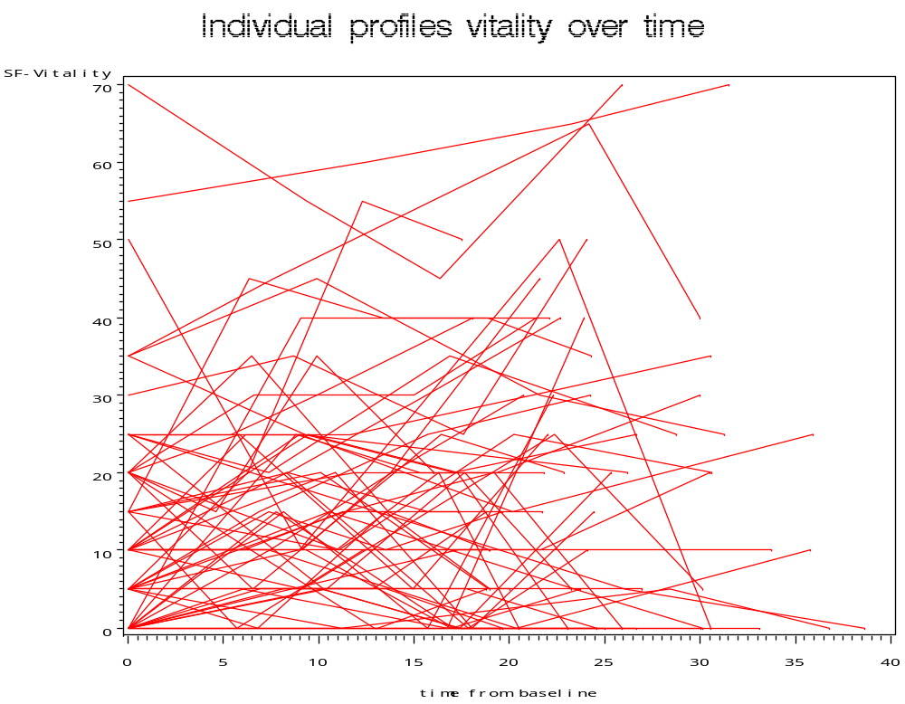
Individual Profiles – SAS Graph Output
Hard to interpret
Gives a clue
Decreasing and increasing vitality scores over time

Slide 40
Average Trend Spline Smoothing – SAS code
goptions reset=all;
proc gplot data=a;
plot sf_vt*time=ID
/ haxis = 0 to 40 by 5
vaxis = 0 to 70 by 10 nolegend;
plot2 sf_vt*time
/ haxis = 0 to 40 by 5
vaxis = 0 to 70 by 10 nolegend;
symbol1 v=none repeat=60 i=join color=red;
symbol2 v=none i=sm50s color=green width=5;
label time="Months since baseline";
title "Average trend spline smoothing";
run;
quit;

Slide 41
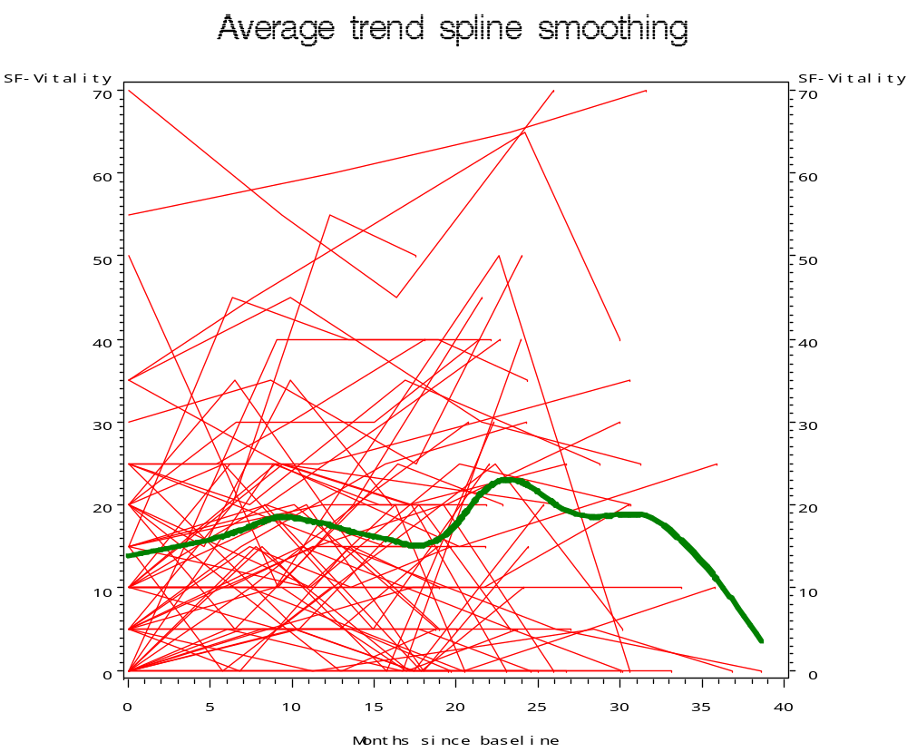
Individual Profiles – SAS Graph Output
Increases in the beginning
Declines towards the end
Indicate quadratic time effect

Slide 42
Profiles and Average Trend
(Linear, quadratic, cubic fits, spline smoothing – SAS Code)
goptions reset=all;
proc gplot data=a;
plot sf_vt*time=1 sf_vt*time=2 sf_vt*time=3 sf_vt*time=4
/ haxis = 0 to 40 by 5
vaxis = 0 to 70 by 10 nolegend overlay;
plot2 sf_vt*time=ID
/ haxis = 0 to 40 by 5
vaxis = 0 to 70 by 10 nolegend;
symbol1 v=none i=rq color=cyan width=3;
symbol2 v=none i=sm50s color=green width=3;
symbol3 v=none i=rc color=magenta width=3;
symbol4 v=none i=r color=black width=3;
symbol5 v=none repeat=60 i = join color=red;
label time="Months since baseline";
title "Spline/linear/Quadratic/Cubic Trend";
run;
quit;

Slide 43
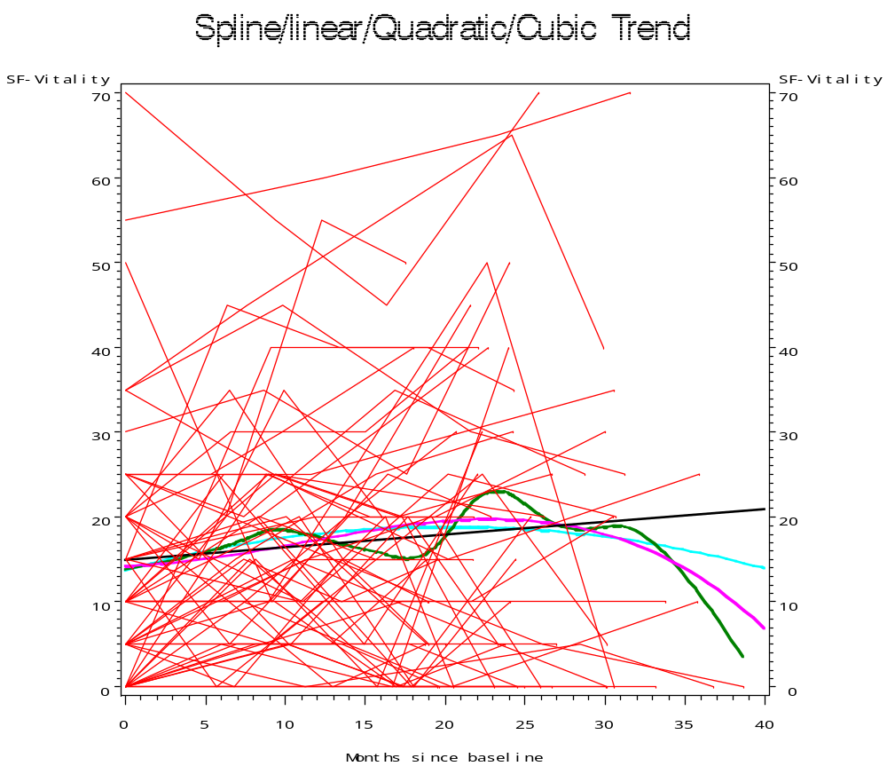
Profiles and Average Trend
(Linear, quadratic, cubic fits, spline smoothing – SAS graph output)
Inference:
Smoothingand different fits help see the pattern of average trend

Slide 44
Profiles and Comorbid FM – SAS Code
proc format; value fm 1 = "Yes" 0 = "NO fm";
goptions reset=all;
proc gplot data=a;
plot sf_Vt*time=id
/ haxis = 0 to 40 by 5
vaxis = 0 to 70 by 10 nolegend;
plot2 sf_vt*time=fm
/ haxis = 0 to 40 by 5
vaxis = 0 to 70 by 10;
symbol1 v=none repeat=60 i=join color=red;
symbol2 v=none i=sm50s color=green width=3 line=1;
symbol3 v=none i=sm50s color=blue width=3 line=2;
format fm fm.;
label time= "Time since baseline";
title "Individual Profiles with Presence/Absence of Comorbid FM";
run;
quit;

Slide 45
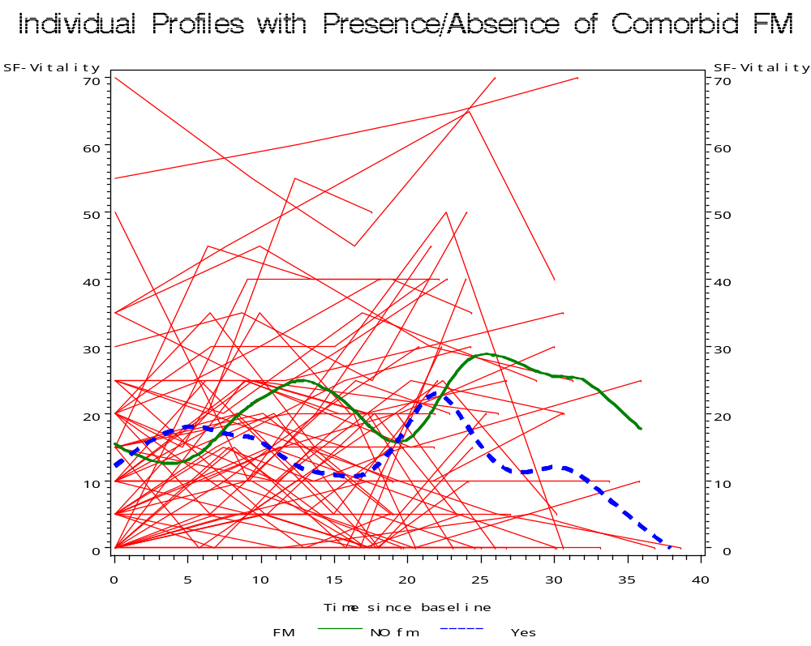
Individual Profiles and Comorbid FM – SAS Graph Output
Inference:
Possible interaction with time?
Decline slower for those without FM

Slide 46
Profiles by Age - SAS Code
proc format;
value agegrp 0 - 35 = "0-35"
36 - 45 = "36-45"
46 - high = "46,+";
goptions reset=all;
proc gplot data=a;
plot sf_Vt*time=id
/ haxis = 0 to 40 by 5
vaxis = 0 to 70 by 10 nolegend;
plot2 sf_vt*time=age
/ haxis = 0 to 40 by 5
vaxis = 0 to 70 by 10;
symbol1 v=none repeat=60 i=join color=red;
symbol2 v=none i=sm50s color=green width=3 line=1;
symbol3 v=none i=sm50s color=blue width=3 line=2;
symbol4 v=none i=sm50s color=magenta width=3 line=3;
format age agegrp.;
label time= "Time since baseline";
title "Individual Profiles and agegrp";
run; quit;

Slide 47
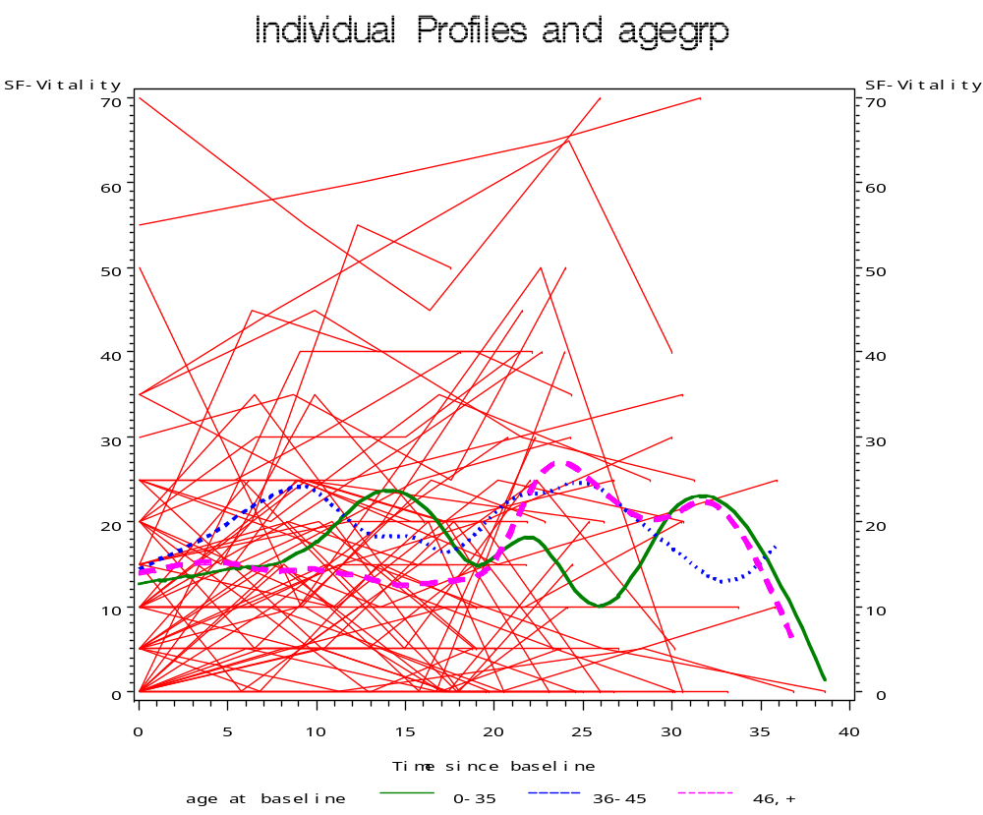
Profiles by Age - SAS Graph Output
There seems to be a relationship between age and trend in vitality; Older individuals grow slowly and start declining at earlier than others

Slide 48
Profiles by Time Varying Covariates Baseline relationships- SAS Code
Proc sort; by id flup;
data baseline ;
set a(rename=(sf_vt=base_sf_vtbdi_deprn=base_bdi_deprn));
by id;
if (first.id) then do;
keep id base_sf_vt base_bdi_deprn;
output;
end;
goptions reset=all;
proc gplot data=baseline;
plot base_sf_vt*base_bdi_deprn
/ vaxis = 0 to 70 by 10
haxis = 0 to 40 by 5;
plot2 base_sf_vt*base_bdi_deprn
/ vaxis = 0 to 70 by 10
haxis = 0 to 40 by 5;
symbol1 v=circle color=red;
symbol2 v=none i=sm50s color=green width=5;
label base_sf_vt = 'Baseline Vitality'
base_bdi_deprn = 'Baseline BDI depression';
title 'Baseline Vitality and Baseline Depression';
run;quit;

Slide 49
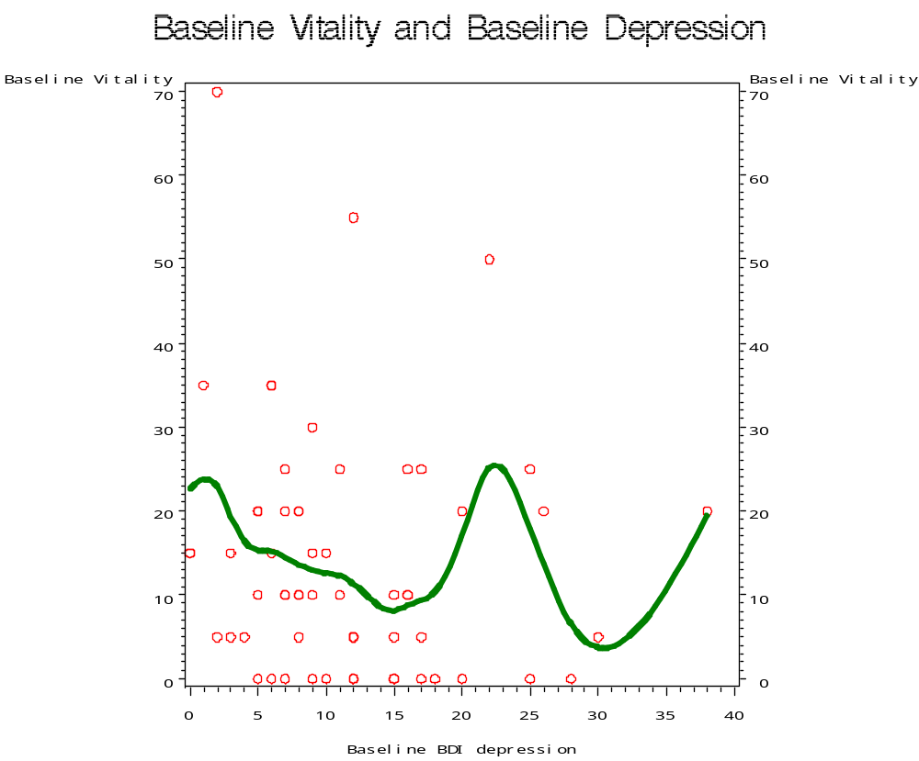
Profiles by Time Varying Covariates Baseline relationships- SAS Graph output

Slide 50
Profiles by Time Varying Covariates Longitudinal relationships - SAS Code
proc sort; by id flup;
data changes ;
set a; by id;
if (first.id) then do;
base_sf_vt = sf_vt;
base_bdi_deprn = bdi_deprn;
end;
retain base_bdi_deprn base_sf_vt;
if ~(first.id) then do;
keep id chg_sf_vt chg_bdi_deprn;
chg_sf_vt = sf_vt-base_sf_vt;
chg_bdi_deprn = bdi_deprn-base_bdi_deprn;
output changes;
end;
goptions reset=all;
proc gplot data=changes;
plot chg_sf_vt*chg_bdi_deprn
/ vref = 0
vaxis = -40 to 50 by 10
haxis = -30 to 20 by 5;
plot2 chg_sf_vt*chg_bdi_deprn
/ vref = 0
vaxis = -40 to 50 by 10
haxis = -30 to 20 by 5;
symbol1 v=circle color=red;
symbol2 v=none i=sm50s color=green width=5;
label chg_sf_vt = 'chg in Vitality'
chg_bdi_deprn = 'change BDI depression';
title 'Change in Vitality and change in Depression';
run;quit;

Slide 51
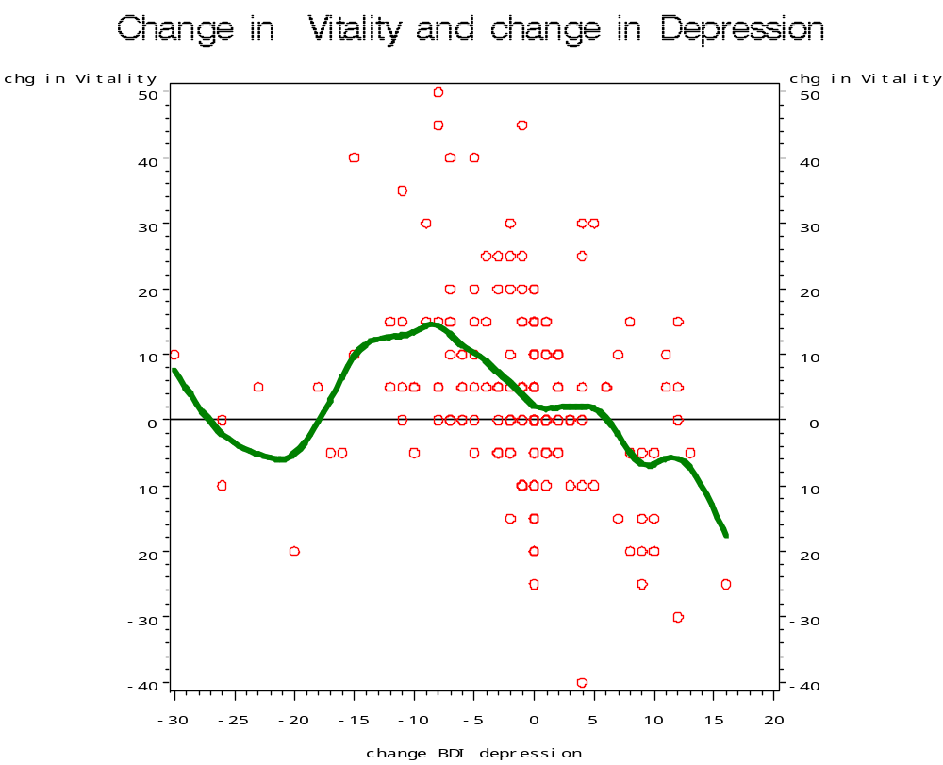
Profiles by Time Varying Covariates Longitudinal relationships - SAS Graph Output

Slide 52
Simple correlations- SAS Output
proc corr data=a nosimple;
var sf_vt time fm age bdi_deprn;
title "Correlations - All observations";
proc corr data=changes nosimple;
var chg_sf_vt chg_bdi_deprn;
title "Correlation of change scores -time varying covariates";
proc corr data=baseline nosimple;
var base_sf_vt base_bdi_deprn;
title "Correlation baseline vitality baseline depression";
run;quit;

Slide 53
Simple correlations- SAS Output
Pearson Correlation Coefficients, N = 239
Prob > |r| under H0: Rho=0
sf_vt time fm age bdi_deprn
sf_vt 1.00000 0.09511 -0.17586 0.04314 -0.26315
SF-Vitality 0.1426 0.0064 0.5069 <.0001
time 0.09511 1.00000 0.00911 -0.00846 0.11135
0.1426 0.8886 0.8965 0.0859
fm -0.17586 0.00911 1.00000 -0.16463 0.20196
FM 0.0064 0.8886 0.0108 0.0017
age 0.04314 -0.00846 -0.16463 1.00000 0.00935
age at baseline 0.5069 0.8965 0.0108 0.8857
bdi_deprn -0.26315 0.11135 0.20196 0.00935 1.00000
Becker Depression inventory <.0001 0.0859 0.0017 0.8857

Slide 54
Simple correlations- SAS Output
Pearson Correlation Coefficients, N = 179
Prob > |r| under H0: Rho=0
chg_bdi_
chg_sf_vt deprn
chg_sf_vt 1.00000 -0.25419
0.0006
chg_bdi_deprn -0.25419 1.00000
0.0006
2 Variables: base_sf_vt base_bdi_deprn
Pearson Correlation Coefficients, N = 60
Prob > |r| under H0: Rho=0
base_
base_ bdi_
sf_vt deprn
base_sf_vt 1.00000 -0.11854
SF-Vitality 0.3670
base_bdi_deprn -0.11854 1.00000
Becker Depression inventory 0.3670

Slide 55
Summary of Exploratory Analysis
There may be a quadratic relationship between time and vitality
Although baseline scores are somewhat similar between those with FM and not with FM, VT scores of those with FM start to decline at an earlier time point
Older individuals seem to have a slower rate of increase in vitality and faster decline in vitality
A negative relationship exists between changes in depression and changes in vitality scores

Slide 56
About PROC MIXED
Can model random and mixed effect data, repeated measures, spatial data, data with heterogeneous variances and autocorrelated observations
3 methods of estimation –
  ML (Maximum Likelihood)
  REML (Restricted or Residual maximum likelihood, which is the default method) and
  MIVQUE0 (Minimum Variance Quadratic Unbiased Estimation)

Slide 57
Covariance Pattern – SAS Code
data a; set examples.mixed;
if (int(age) < 35) then agegrp = 1;
else if (35= < int(age) < 45) then agegrp = 2;
else if (int(age) >= 45) then agegrp = 3;
proc format;
value agegrp 1 = "Lt 35"
2 = "35-45"
3 = ">45";
proc mixed data=a;
class id fm agegrp;
model sf_vt = time time*time fm agegrp bdi_deprn/ s ddfm=kr;
format agegrp agegrp.;
repeated /sub=id type=cs r rcorr;
title 'Longitudinal Model with Compound Symmetry Covariance Structure'
run; quit;

Slide 58
Covariance Pattern -- CS
Estimated R Matrix for id 10029
Row Col1 Col2 Col3 Col4
1 235.38 144.12 144.12 144.12
2 144.12 235.38 144.12 144.12
3 144.12 144.12 235.38 144.12
4 144.12 144.12 144.12 235.38
Estimated R Correlation Matrix for id 10029
Row Col1 Col2 Col3 Col4
1 1.0000 0.6123 0.6123 0.6123
2 0.6123 1.0000 0.6123 0.6123
3 0.6123 0.6123 1.0000 0.6123
4 0.6123 0.6123 0.6123 1.0000
Covariance Parameter Estimates
Cov Parm Subject Estimate
CS id 144.12
Residual 91.2608

Slide 59
Covariance Pattern -- CS
Covariance Parameter Estimates
Cov Parm Subject Estimate
CS id 144.12
Residual 91.2608
Fit Statistics -2 Res Log Likelihood 1867.2
AIC (smaller is better) 1871.2
AICC (smaller is better) 1871.2
BIC (smaller is better) 1875.4
Null Model Likelihood Ratio Test
DF Chi-Square Pr > ChiSq
1 103.18 <.0001
Solution for Fixed Effects
Standard
Effect FM agegrp Estimate Error DF t Value Pr > |t|
Intercept 12.8770 4.7186 69.2 2.73 0.0080
time 0.4250 0.1915 183 2.22 0.0277
time*time -0.00850 0.006588 188 -1.29 0.1984
fm 0 4.5788 3.4206 56.9 1.34 0.1860
fm 1 0 . . . .
agegrp 35-45 3.4817 4.9559 56 0.70 0.4852
agegrp >45 2.5234 4.7671 55.8 0.53 0.5987
agegrp Lt 35 0 . . . .
bdi_deprn -0.3716 0.1154 231 -3.22 0.0015

Slide 60
Random Intercept, Slope Model
(SAS Code)
proc mixed covtest method=reml noclprint;
class id;
model sf_vt = time / s;
random intercept time /sub=id type=un gcorr;
run; quit;

Slide 61
GL Mixed Model Building
proc mixed covtest method=reml noclprint;
class id;
model sf_vt = time time*time / s;
random intercept /sub=id type=un gcorr;
proc mixed covtest method=reml noclprint;
class id fm;
model sf_vt = time time*time fm/ s;
random intercept /sub=id type=un gcorr;
proc mixed covtest method=reml noclprint;
class id fm agegrp;
model sf_vt = time time*time fm agegrp/ s;
format agegrp agegrp.;
random intercept /sub=id type=un gcorr;
proc mixed covtest method=reml noclprint;
class id fm agegrp;
model sf_vt = time time*time fm agegrp bdi_deprn/ s;
format agegrp agegrp.;
random intercept /sub=id type=un gcorr;
run; quit;

Slide 62
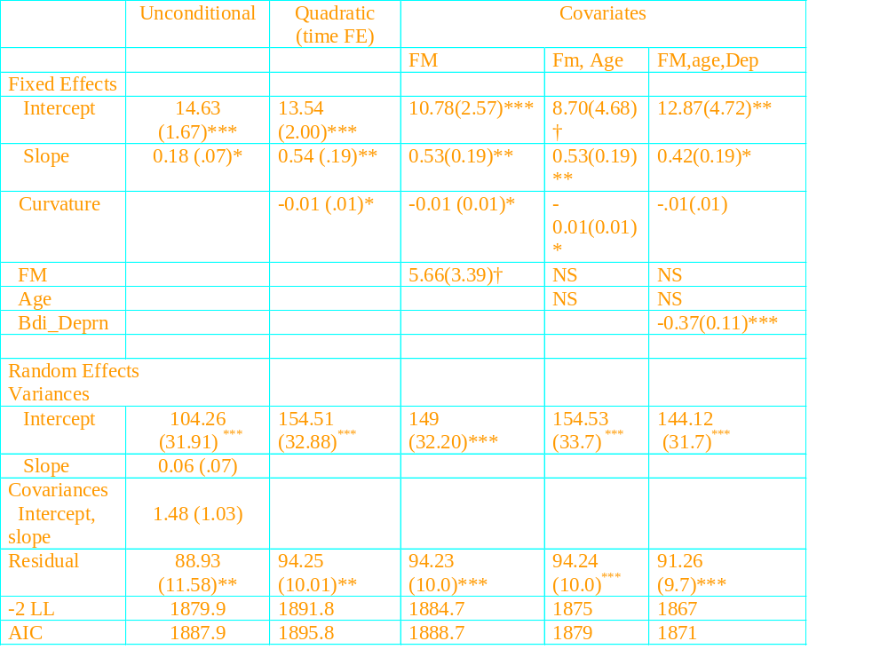
Model Summary

Slide 63
Interpreting Random Intercept, Slope models
61% of the total variability in vitality over time and across people is due to between person differences or individual differences
The remainder 39% is how much people vary from themselves over time.
The variance of the intercept was the estimated variance of the individual deviations from the overall intercept and was significantly different from zero, reflecting significant individual differences in vitality
The variance estimate for the slope was not significantly different from zero, indicating that people did not vary in rate of change.

Slide 64
Summary of Findings
The model with random intercepts, and time as fixed effects with a quadratic term seems to best describe the differences in vitality scores and changes in vitality over time
No relationship between Age and vitality
No relationship exits between FM and vitality
Depression was negatively associated with vitality

Slide 65
What if we had done OLS ?
Dependent Variable: sf_vt SF-Vitality
Analysis of Variance
Sum of Mean
Source DF Squares Square F Value Pr > F
Model 6 6446.48084 1074.41347 4.69 0.0002
Error 232 53106 228.90620
Corrected Total 238 59553
Root MSE 15.12965 R-Square 0.1082
Dependent Mean 16.88285 Adj R-Sq 0.0852
Coeff Var 89.61550
Parameter Estimates
Parameter Standard
Variable Label DF Estimate Error t Value
Intercept Intercept 1 18.20446 3.16026 5.76
time 1 0.36910 0.28883 1.28
timesq 1 -0.00615 0.00959 -0.64
fm* FM 1 -4.23316 2.03175 -2.08
agegrp2 1 3.73914 2.91263 1.28
agegrp3 1 2.61273 2.79285 0.94
bdi_deprn** Becker Depression inventory 1 -0.46112 0.11980 -3.85
<.0001 0.2026 0.5217 0.0383
0.2005 0.3505 0.0002

Slide 66
References
Charlie Hallahan, Sigstat
HLM workshop – Rodenbush
Book on HLM – Byrk and Rodenbush
Proc Mixed – SAS Manual
J Singer – Growth Models
SUGI

